Slide 1

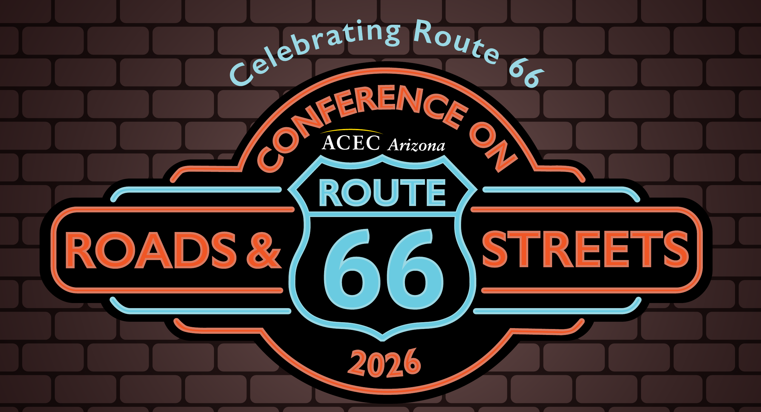
GREEN LIGHT
What RTA Next Teaches Us About Winning at the Ballot Box
Chris Bridges | Alejandro Angel | Cristie Street
September 24, 2026 | 10:45 AM - 11:45 AM | Coronado Ballroom
Notes:
CHRIS

Slide 2
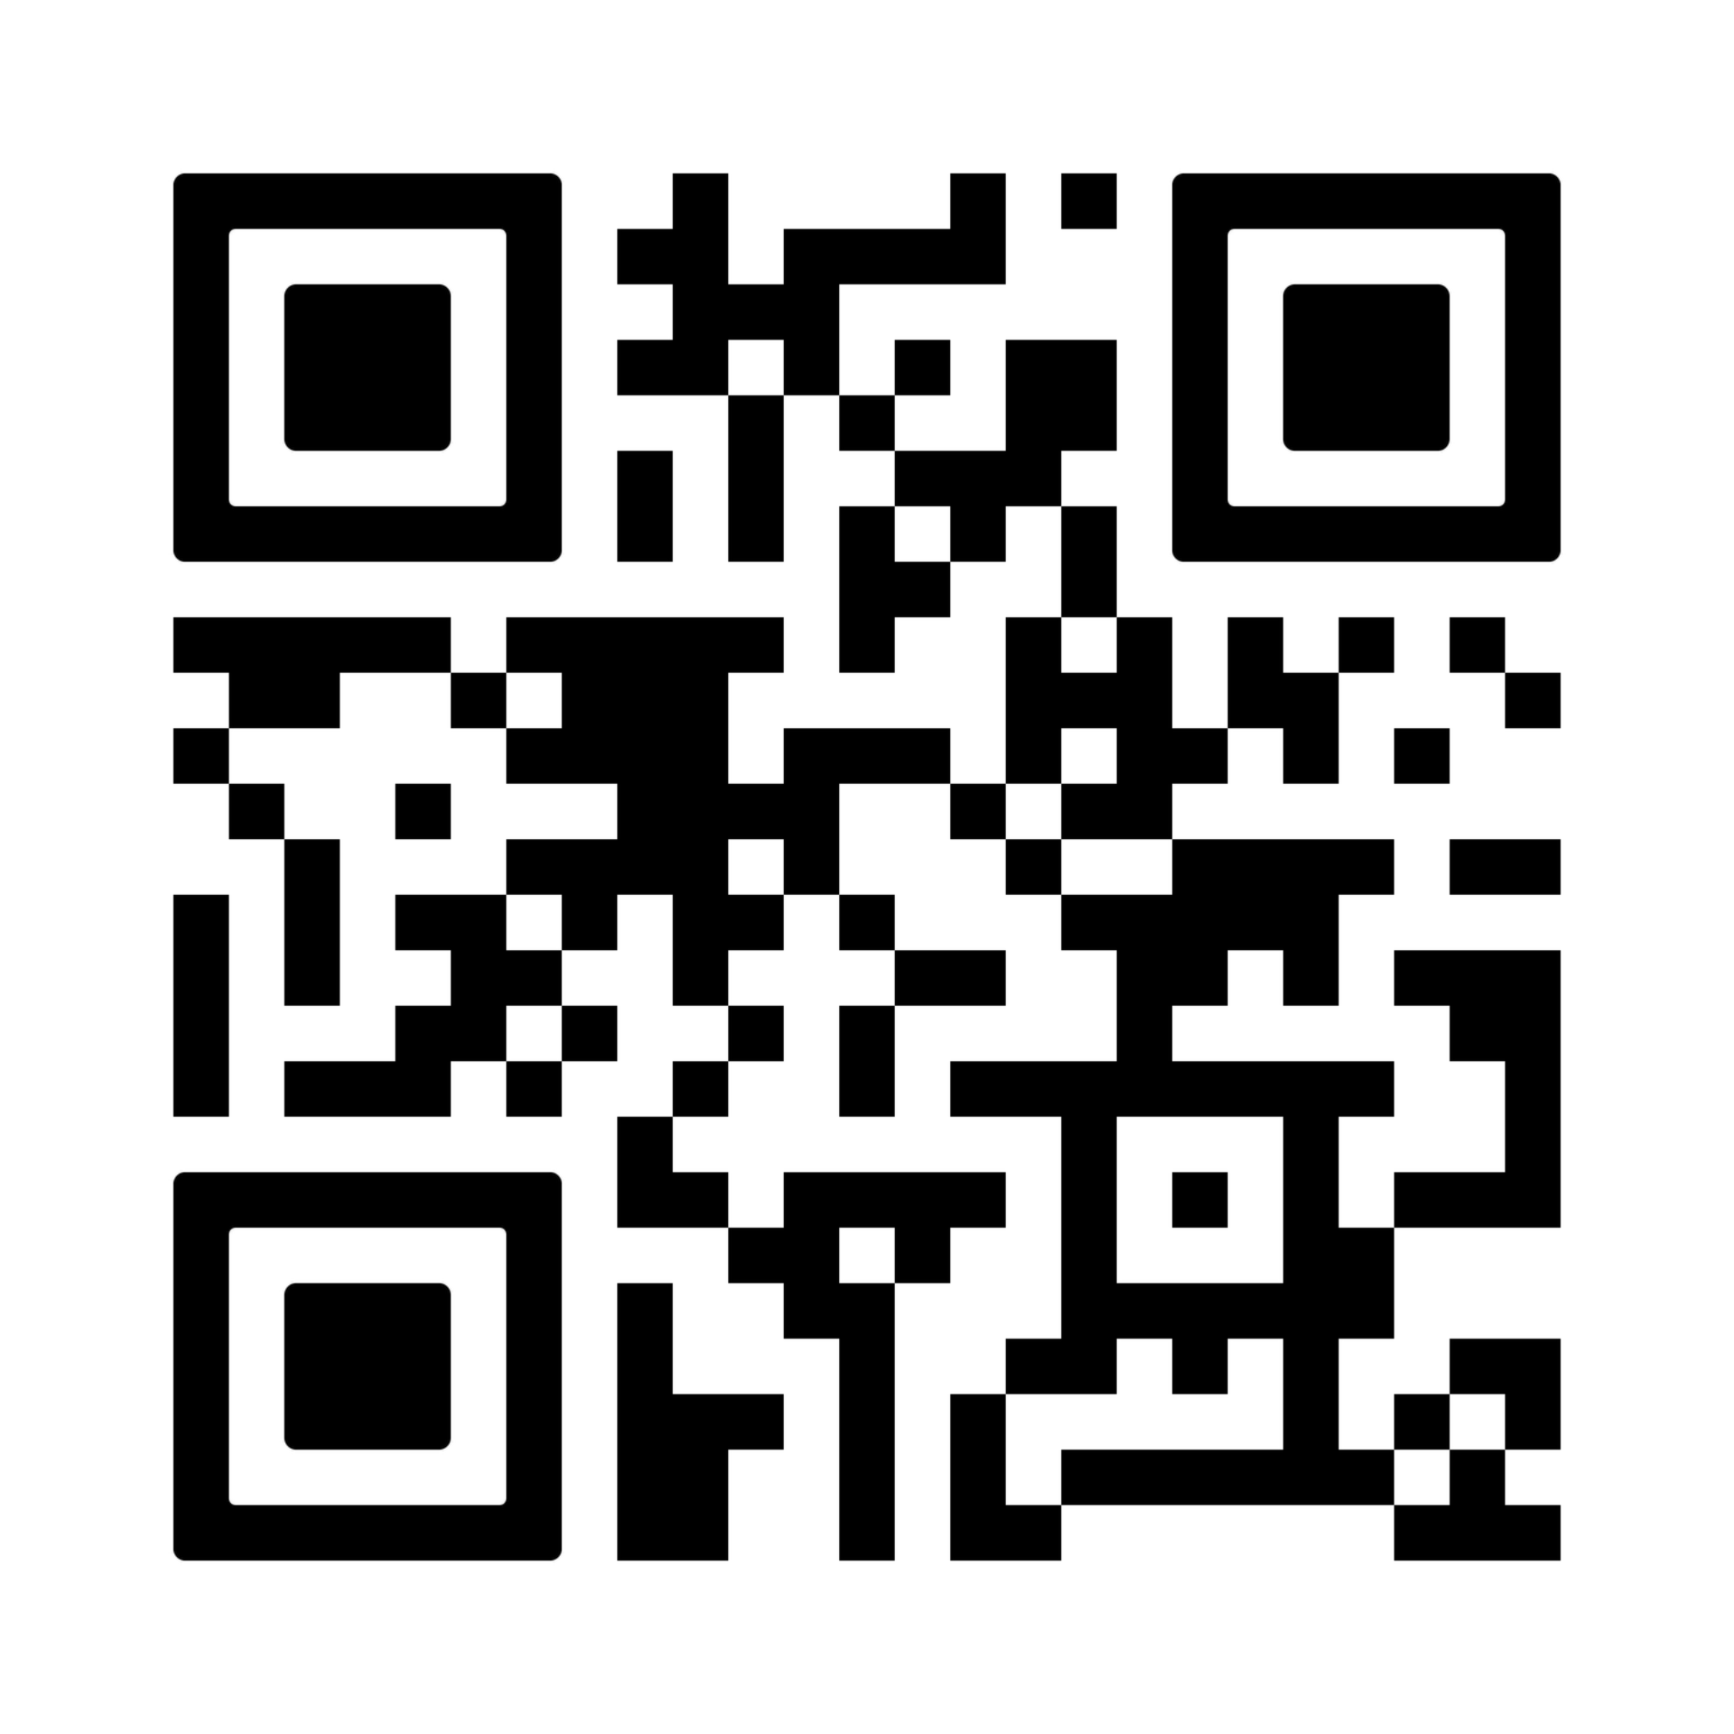
SESSION CHECK-IN & LIVE Q&A
Scan once to check in, submit questions and participate during the session.
SESSION CODE
7ca0efe3-b186-4c24-88c8-accd753b3719
September 24, 2026 | 10:45 AM - 11:45 AM | Coronado Ballroom.
SCAN FOR LIVE SESSION
Notes:
CHRIS

Slide 3
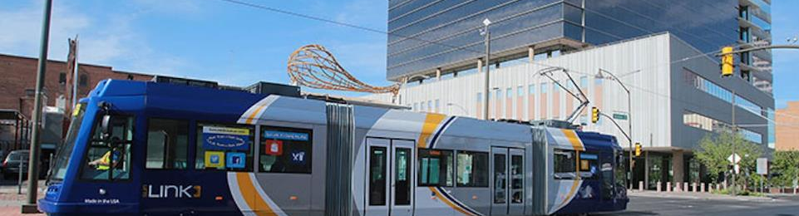
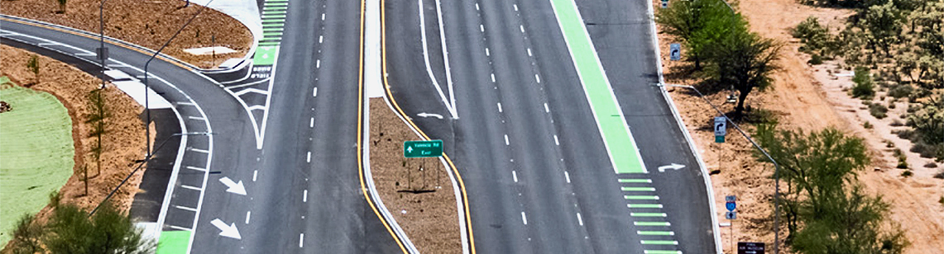
RTA NEXT – The Two Question Renewal for Pima County
Coronado Ballroom
20 years
$2.67 billion
½-cent tax
Regional transportation investment
Same rate
418
THE PLAN
419
THE FUNDING
Roads · transit · safety · environment
A 20-year sales-tax authorization
ROADS & STREETS 2026
Notes:
CHRIS

Slide 4
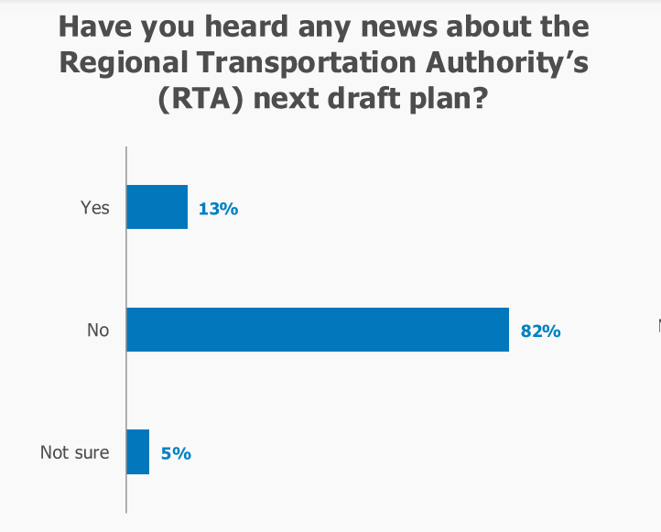
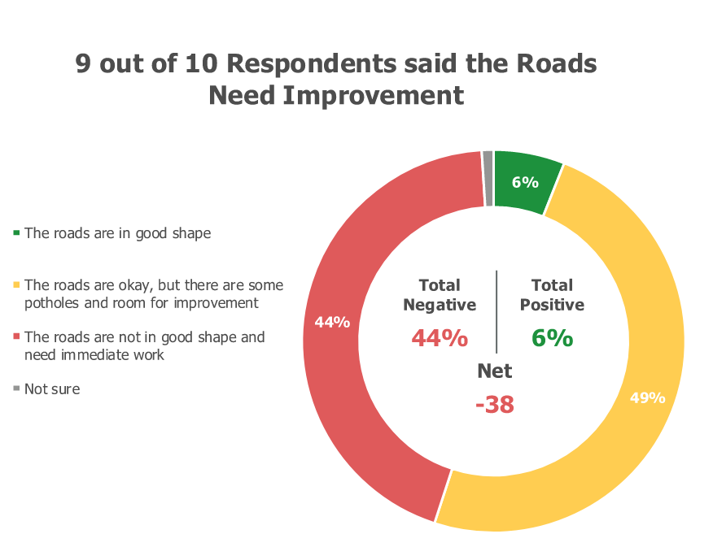
THE SPRING OF OUR DISCONTENT
Coronado Ballroom
FEBRUARY 2025 POLLING DATA
ROADS & STREETS 2026
Notes:
AA
Looming deadline in order to maintain Transit and avoid lapse in funding
Mike Ortega appointed
Clarity on how to deliver remainder of RTA 1
Change in momentum
Sense that those of us supporting the effort were suddenly behind

Slide 5
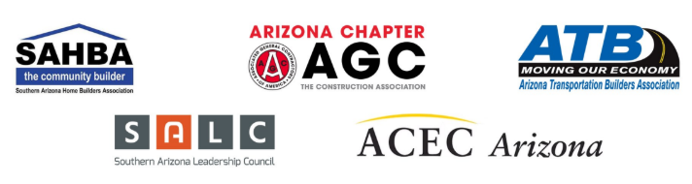
THE PLEDGES MADE IT REAL
Coronado Ballroom
THE EARLY COALITION
$500,000+
in early pledges
Before the measure
reached the ballot.
Our Message to the Community:
“This train is leaving the station. Get onboard!”
ROADS & STREETS 2026
Notes:
CRISTIE

Slide 6
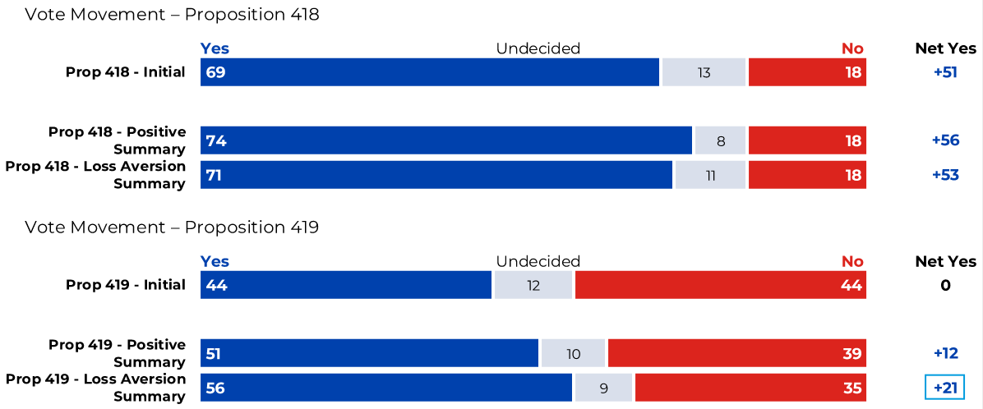
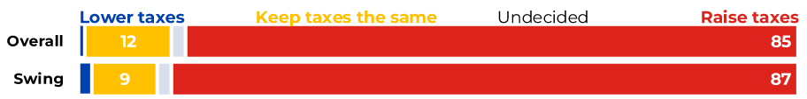
CLEARING UP THE MISCONCEPTIONS
Coronado Ballroom
November 2025: Plan had high level of support; Funding question needed work!
If these measures were to pass, they would…
ROADS & STREETS 2026
16
Notes:
AA

Slide 7
THE RISK: A PLAN WITHOUT ITS FUNDING
Coronado Ballroom
VOTE YES TWICE.
YES
YES
+
ON 418
ON 419
If 418 or 419 fails that means more potholes, more congestion, and less safety.
We can’t rely on others to fix our roads and keep us safe.
With 418 and 419, we can put Pima County on the right track, all while continuing to pay the same in taxes.
Yes on 418 and 419 means repaving major roads, fewer potholes and safer streets.
But remember, it takes two Yes votes. So vote Yes on both 418 and 419.
ROADS & STREETS 2026
Notes:
CRISTIE

Slide 8
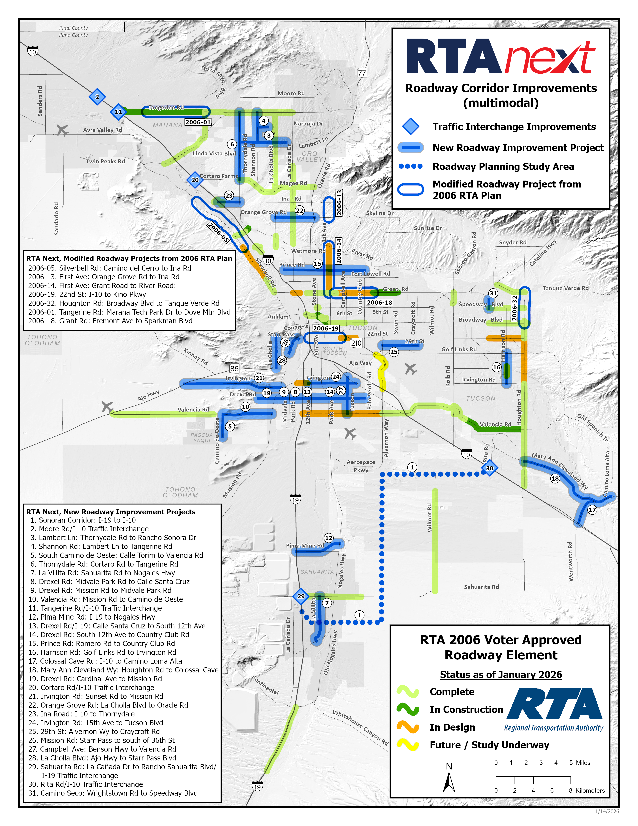
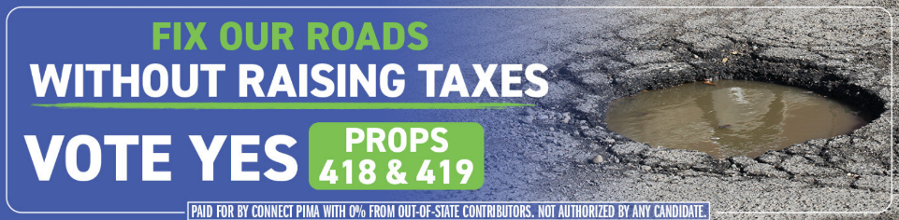
THE RESEARCH CHANGED THE MESSAGE
Coronado Ballroom
Different projects.
One shared frustration.
Potholes.
JANUARY 2026 PLAN MAP
ROADS & STREETS 2026
Notes:
AA

Slide 9
EDUCATION FIRST. THEN ADVOCACY.
Coronado Ballroom
PAG / RTA STAFF
CAMPAIGN / COALITION
Explain the plan
and the funding.
Make the case
for two YES votes.
Campaign Monthly Updates
Steering Committee Weekly Meetings
  Speakers Bureau
  Social/Viral Engagement
  Associations/Members
  Major Employers
  Neighborhoods
  Press & Media
  Political Parties & Precincts
Mike Ortega and PAG team
≈300
8,000+
groups addressed
people reached
ROADS & STREETS 2026
Notes:
AA

Slide 10
GRASSTOPS + GRASSROOTS
Coronado Ballroom
GRASSTOPS
GRASSROOTS
Leaders + paid reach
People + trusted networks
Business and industry support
Campaign funding
YouTube · broadcast · print · radio
Neighborhood meetings
Industry associations
Friends talking to friends
One campaign message, carried through many relationships.
ROADS & STREETS 2026
11
Notes:
CRISTIE

Slide 11
CAMPAIGN FINANCE
Coronado Ballroom
OFFICIAL FUNDRAISING
OFFICIAL SPENDING
Raised $1.5M
200-250k from Engineering Industry
500-600k from contractors
Remaining from local businesses (Realtors, auto dealers, SALC)
82% = TV, Radio, Direct Mail
7.5% = Polling, Surveys, Journaling
5% = Consultant Staff
5% = Other administrative
Optional takeaway or source note
ROADS & STREETS 2026
05
Notes:
AA

Slide 12
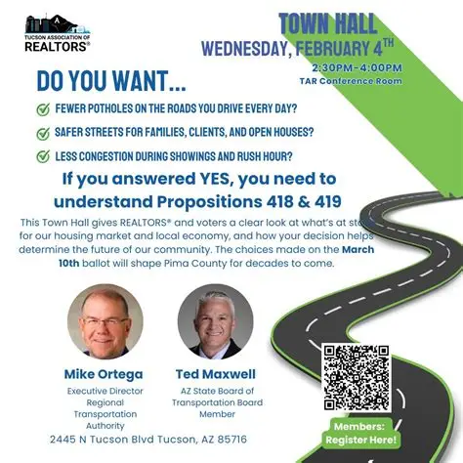
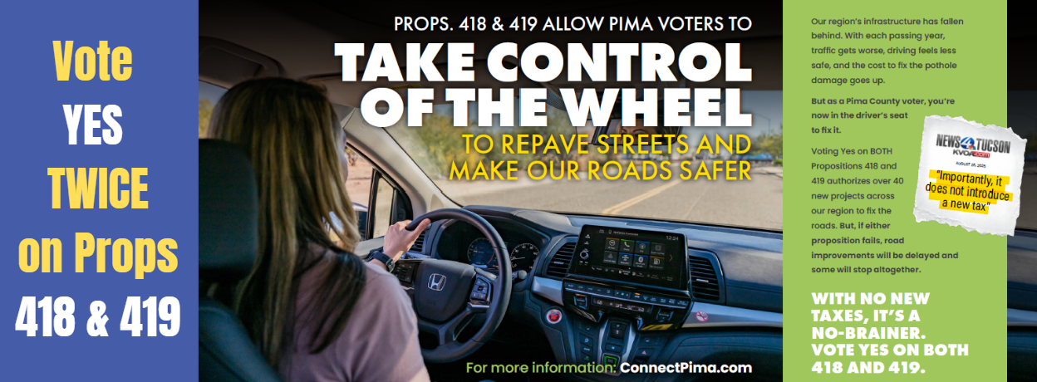
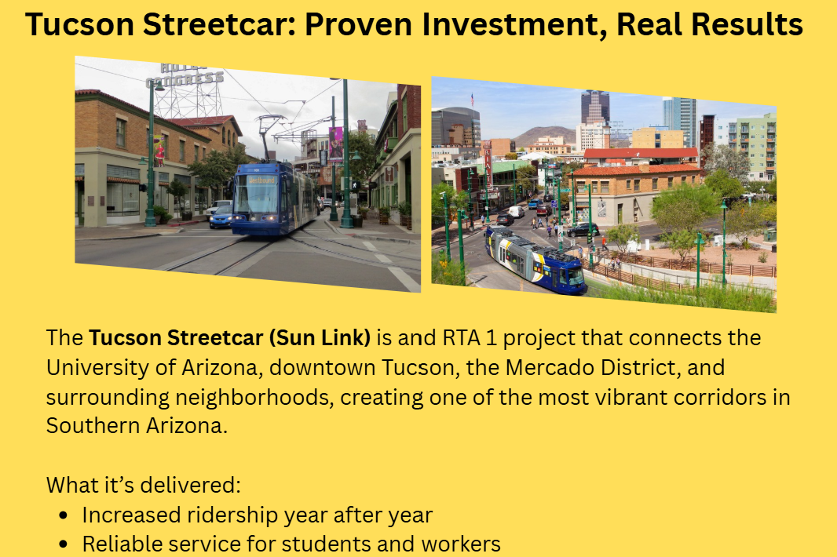
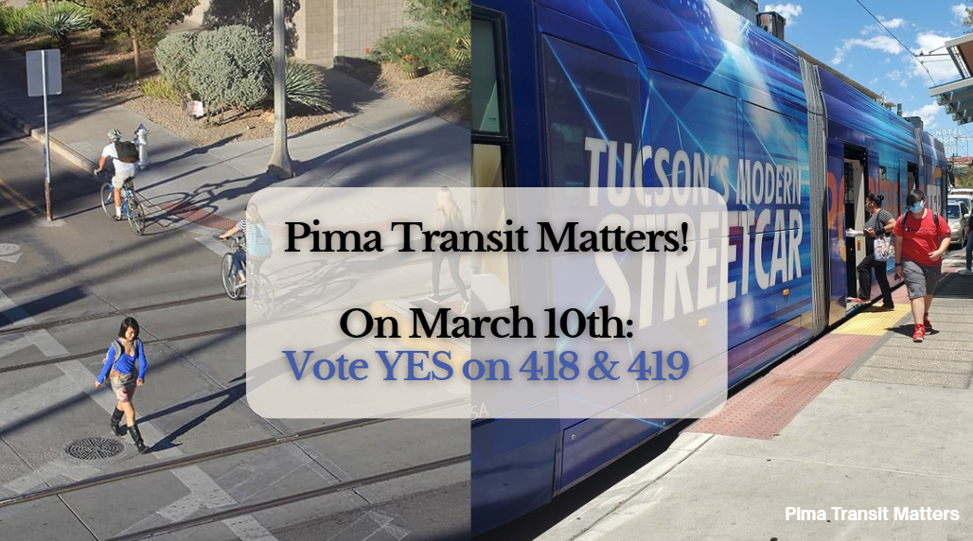
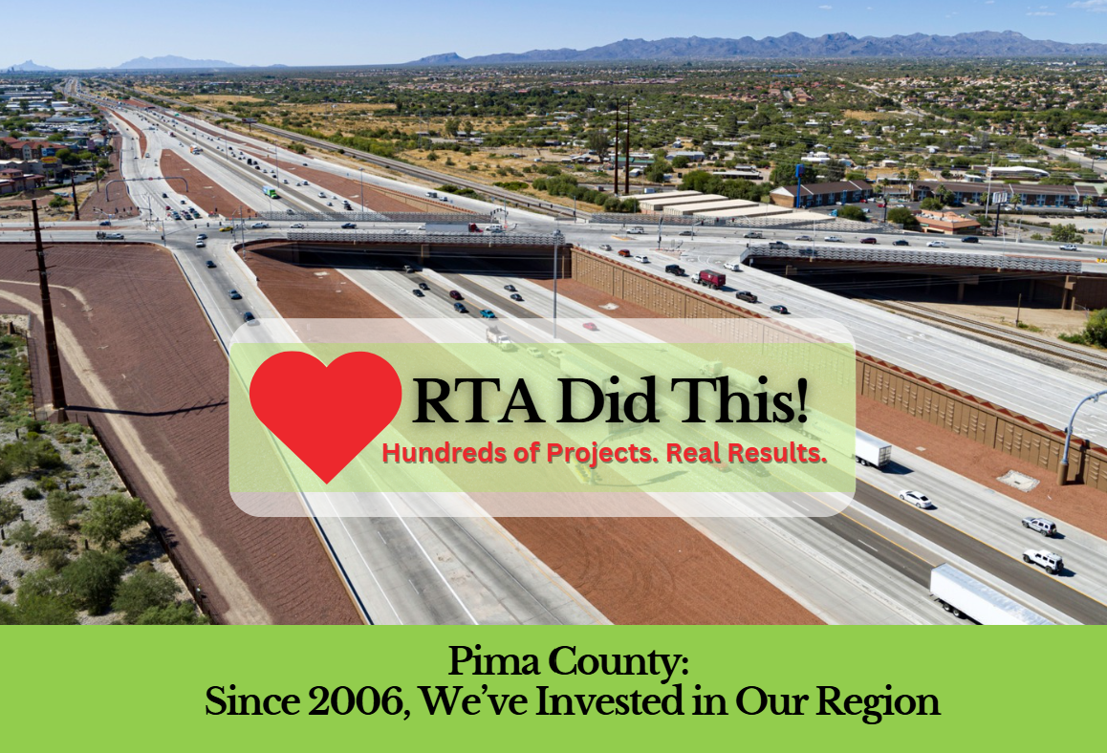
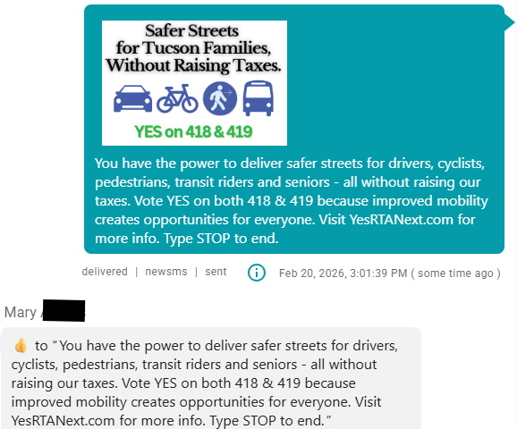
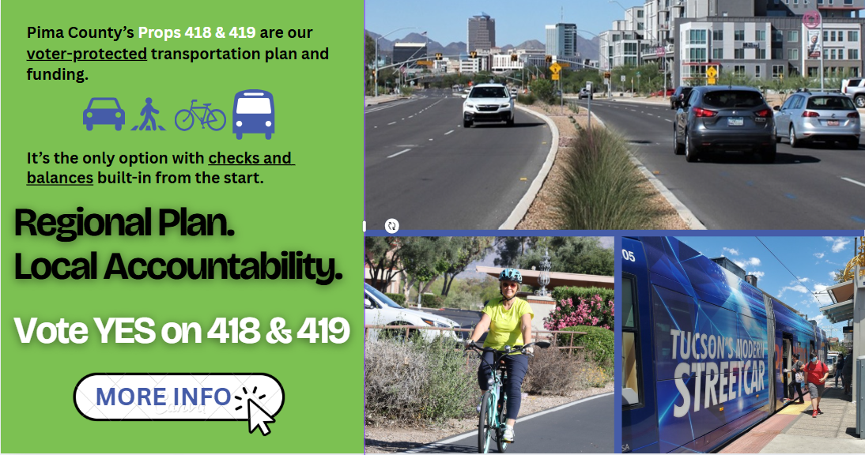
THE REACH OF YES + YES
Coronado Ballroom
For more benefits of RTA Next, visit all our informational sites:
Pimatransitmatters.com
Yesforallpima.com
TwoYesVotesZeroTaxIncrease.com
PimaRoadSafety.com
InvestinOurselves.com
RTAdidThis.com
Yes418and419.com
KeepPimaMoving.com
VoteYesonBoth.com
MomsforRTA.com
ROADS & STREETS 2026
12
Notes:
CRISTIE

Slide 13
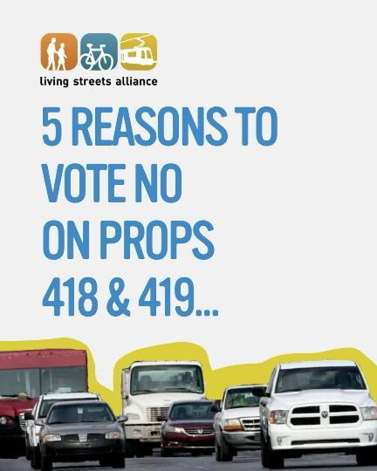
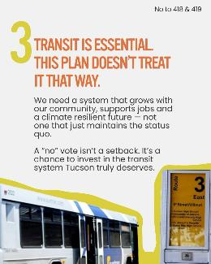
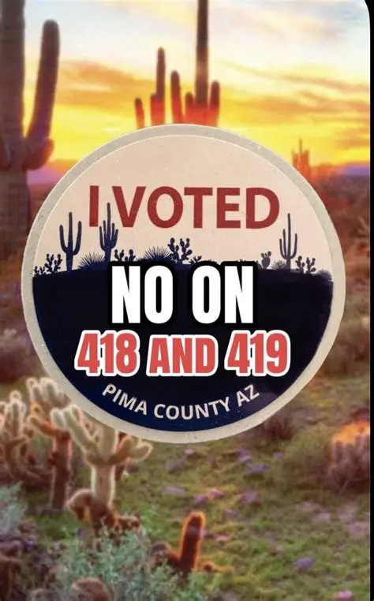
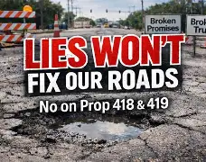

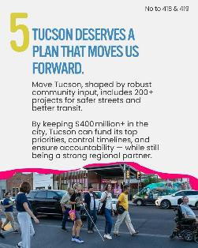
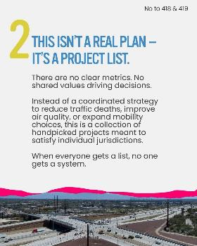

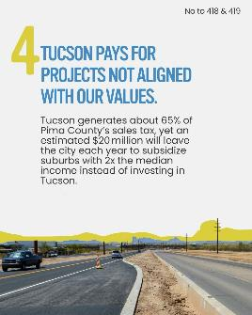
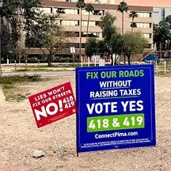
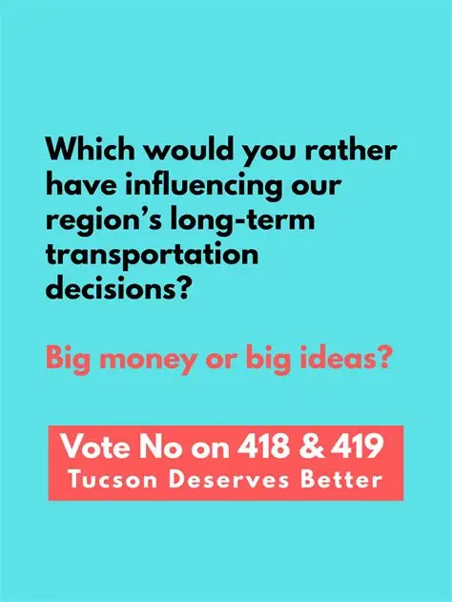

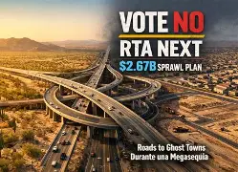
THE NO CAMPAIGN(S)
Coronado Ballroom
ROADS & STREETS 2026
12
Notes:
AA

Slide 14
BOTH PASSED. THE TAX TRAILED THE PLAN.
Coronado Ballroom
Mail-only election (March 10, 2026)
Only questions on ballot
Official results
50%
60.4%
418 · PLAN
125,362 YES / 82,128 NO
58.3%
419 · FUNDING
120,381 YES / 86,236 NO
209,533
31.73%
4,981
ballots cast
turnout
fewer YES votes for funding
ROADS & STREETS 2026
16
Notes:
CHRIS

Slide 15
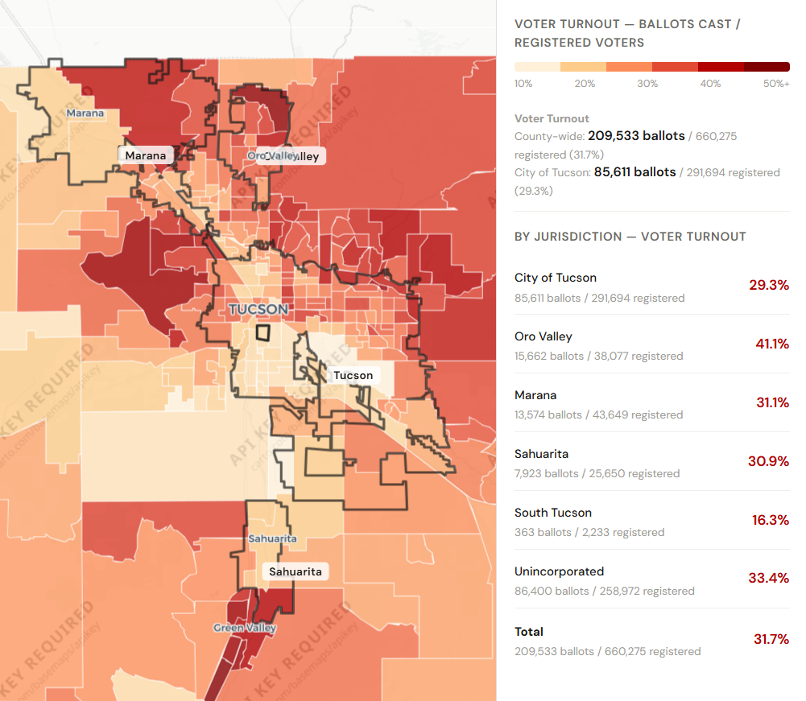
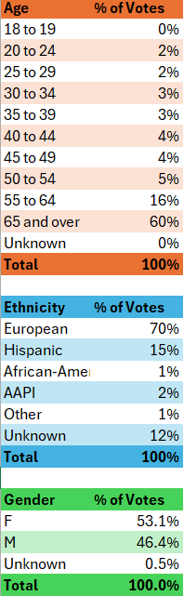
ANALYSIS OF RESULTS
Turnout
Optional caption
ROADS & STREETS 2026
Notes:
AA

Slide 16
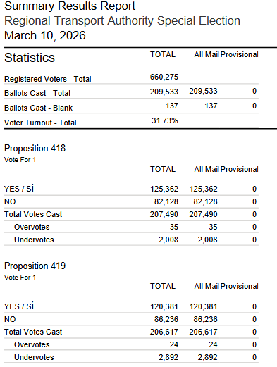
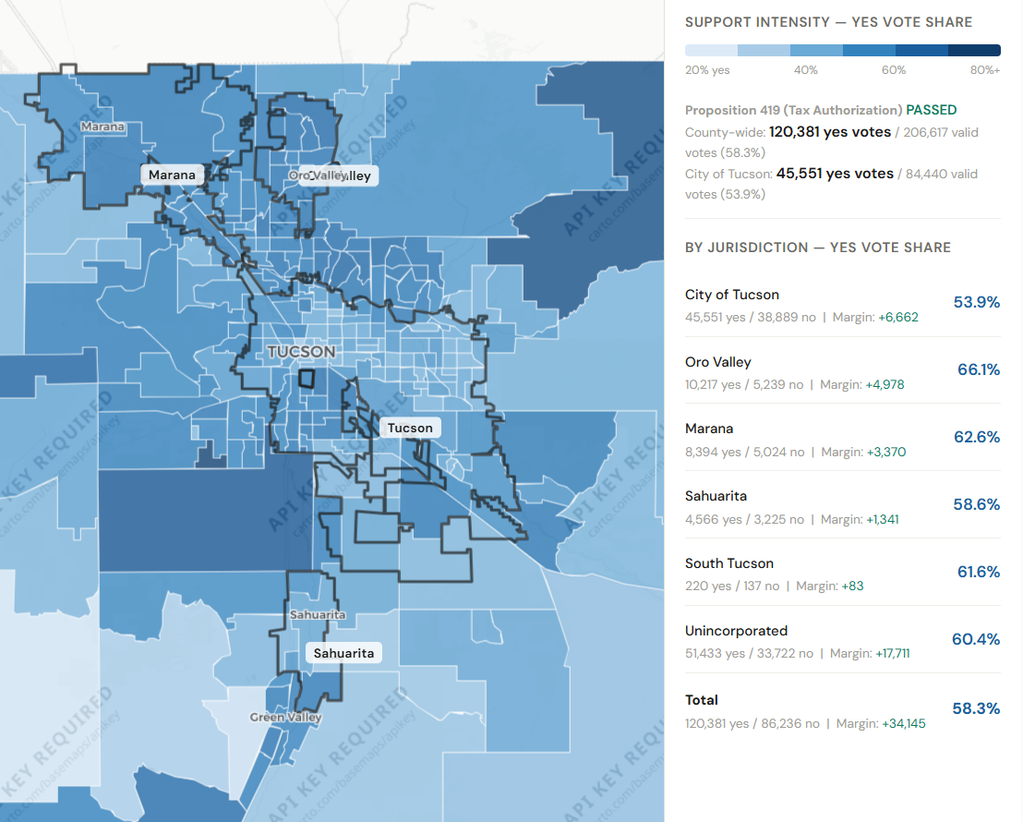
ANALYSIS OF RESULTS
Level of Support
Optional caption
ROADS & STREETS 2026
Notes:
AA

Slide 17
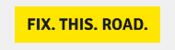
WHAT WE WOULD KEEP — AND CHANGE
Coronado Ballroom
KEEP
EXPAND
SPEND LESS TIME
Early commitments
Research-led, simple messaging
Grasstops + Grassroots
Hyper-local messages and outreach with
trusted local voices
Traditional op-eds
and letters
to the editor
For example:
Spanish-language radio ads in Ward 1 & 5
Pima loves yard signs.
We could have been even more localized with signs messaging.
Legacy press outreach offered less breadth than in past campaigns.
If you’re explaining, you’re losing.
ROADS & STREETS 2026
17
Notes:
CRISTIE

Slide 18
THE WORK STARTS
BEFORE THE BALLOT.
Build the support that gets it to voters.
Then earn the votes that fund it.
Notes:
CRISTIE

Slide 19
QUESTIONS & DISCUSSION
Coronado Ballroom
What would be different
in your community?
Who has to commit before referral?
What does the individual voter value?
Which trusted voices can reach them?
SCAN FOR LIVE Q&A
Same session check-in code
Session QR code reproduced from the supplied conference template.
ROADS & STREETS 2026
19

Slide 20
BEFORE THERE WAS A BALLOT
Coronado Ballroom
Leadership crisis. No final plan. No referral.
An expiring funding mechanism gave the region a deadline.
COALITION PREP WORK
CAMPAIGN
Organize · pledge · lobby the board
AUG. 25, 2025
RTA Board approves plan
Expand coalition
Launch campaign
Begin voter research
SEPT. 2, 2025
ORTEGA + MAXWELL
Pima Board of Supervisors refers to March ballot
Bring a compromise plan forward
The coalition helped create the conditions (and urgency) for a ballot referral.
ROADS & STREETS 2026

Slide 21
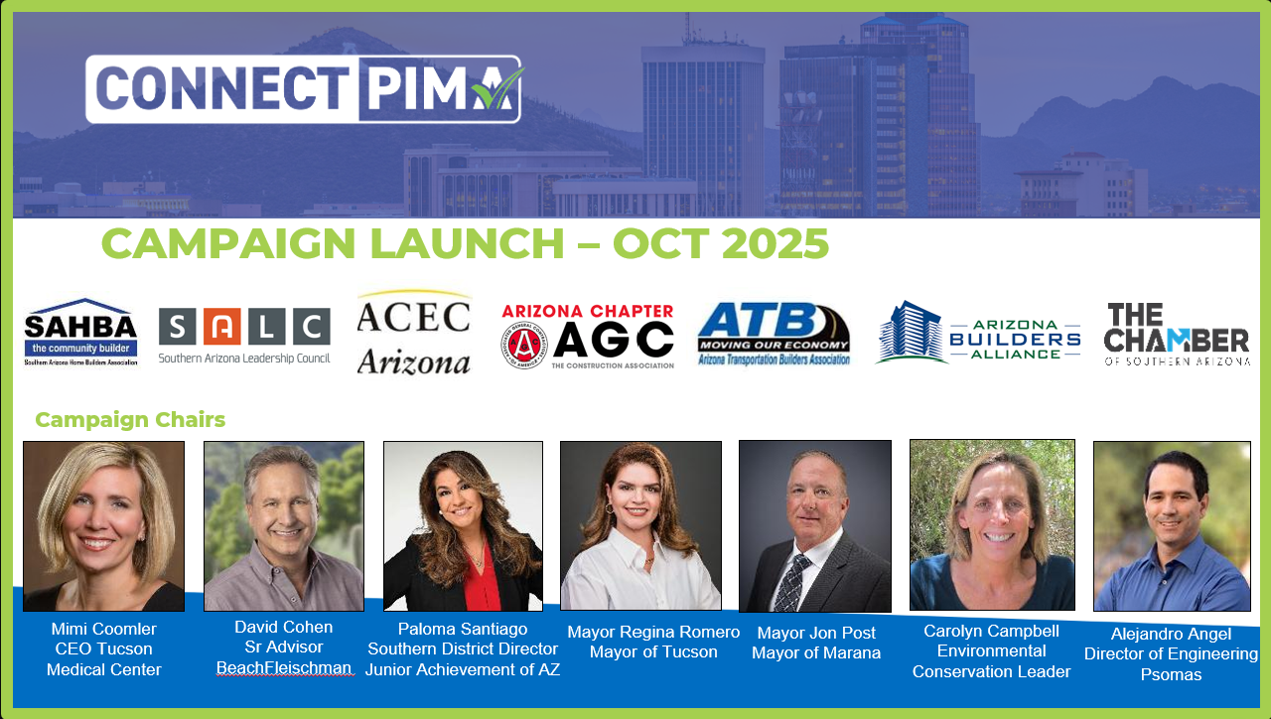
THE YES + YES CAMPAIGN
Coronado Ballroom
November 2025: Plan had high level of support; Funding question needed work!
ROADS & STREETS 2026

Slide 22
STAKEHOLDER MATH ≠ VOTER MATH
Coronado Ballroom
STAKEHOLDER
INDIVIDUAL VOTER
“My priority belongs
in this plan.”
“What’s in it
for me?”
Decision criteria we often heard:
Transit
Interchanges
Bike lanes
My daily travel experience is…
What is the cost to me?
Do I trust the promise or the system?
Does regionality make sense/is it fair?
Anti-growth, sprawl or car-dependency…
If we don’t invest in ourselves, who will?
Safety
Conservation corridors
Champions explain why their component
belongs in a regional investment.
ROADS & STREETS 2026

Slide 23
WHY POTHOLES LED THE MESSAGE
Coronado Ballroom
$177.6 million
for pavement rehabilitation
6.7%
Controversial, but understood:
of the plan
Potholes vs. Pavement Rehabilitation
Why lead with such a small slice? It was a rapid fix to a universal concern voters shared across the county.
ROADS & STREETS 2026

Slide 24
VOTING BEGAN BEFORE ELECTION DAY
Coronado Ballroom
All-mail election · March 10, 2026
FEB 11
MAR 3
MAR 10
Ballots mailed
Mail-back guidance
Election Day
Decisions begin
before Election Day.
Recommended latest date
to put ballots in the mail.
Ballots due
by 7 p.m.
ROADS & STREETS 2026
15

Slide 25

THANK YOU TO OUR SPONSORS
Your support helps bring Roads & Streets 2026 to life
Arizona’s Roads, Our Nation’s Journey

