Slide 1
Pima Early Education Program Scholarships
EDUCATION | BUSINESS | POLITICAL | PHILANTHROPIC
Superintendents of School Districts Southern Arizona Association of Early Childhood Education Children’s Action Alliance Child and Family Resources First Things First Center for Economic Integrity Arizona Early Childhood Alliance Arizona Head Start Association Arizona Children’s Association Pima County Joint Technical Education Districts: Altar Valley, Amphi, Flowing Wells, Marana, Sahuarita, Sunnyside, T.U.S.D., Vail School Districts La Frontera | Southern Arizona Leadership Council Auto Dealers Real Estate Development, Design, Construction, Sales Hospitals and Healthcare Finance Utilities / Telecommunications Media University of Arizona / Pima Community College Mining and Minerals Professional Services Research, Development and Manufacturing: Medical, Optical, Military, Mining, Equipment Private Enterprise Distribution and Logistics Hospitality | Pima County Board of Supervisors, County Manager and Staff Rex Scott, Adelita Grijalva, Dr. Matt Heinz, Jennifer Allen, Steve Christy Arizona Department of Economic Security Pima Superintendent of Schools and Staff City of Tucson Mayor and Staff Town of Marana Mayor, Council and Staff Town of Oro Valley Mayor Council and Staff Arizona Legislature Arizona Governor Pima County Library Improvement District | United Way CEO Tony Penn Vice President Monica Brinkerhoff Literacy Connects Make Way for Books Big Brothers and Big Sisters YMCA / YWCA United Way of Tucson and Southern Arizona Diamond Family Foundation El Rio Health Marshall Foundation Women’s Foundation for the State of Arizona Tucson Values Teachers La Frontera

Slide 2
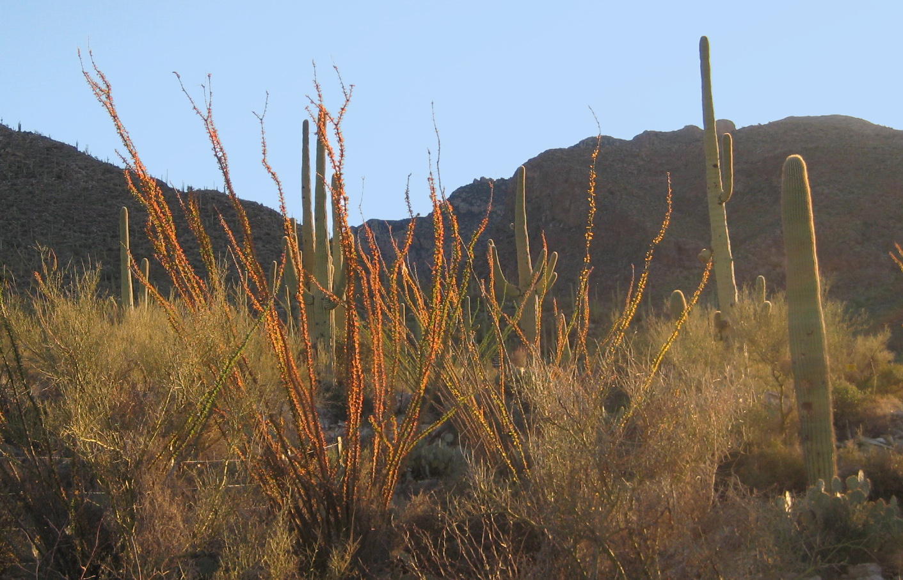
Tucson Values Literacy Creativity Science

